Slide 1
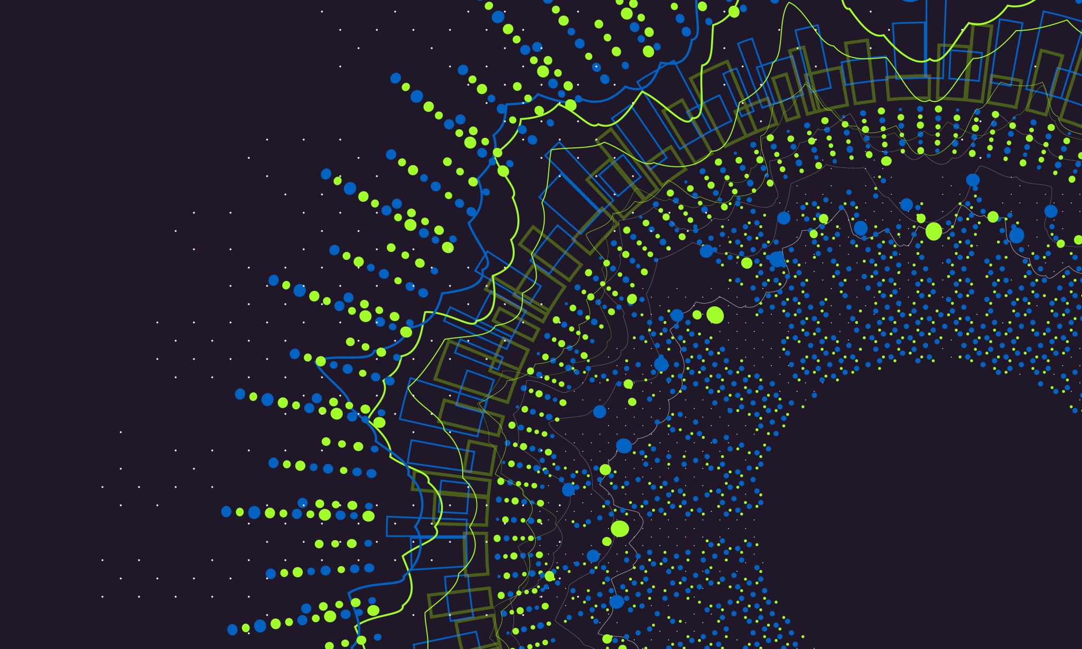

Star Wars Chatbot
Julia Cuellar
DSC 680

Slide 2

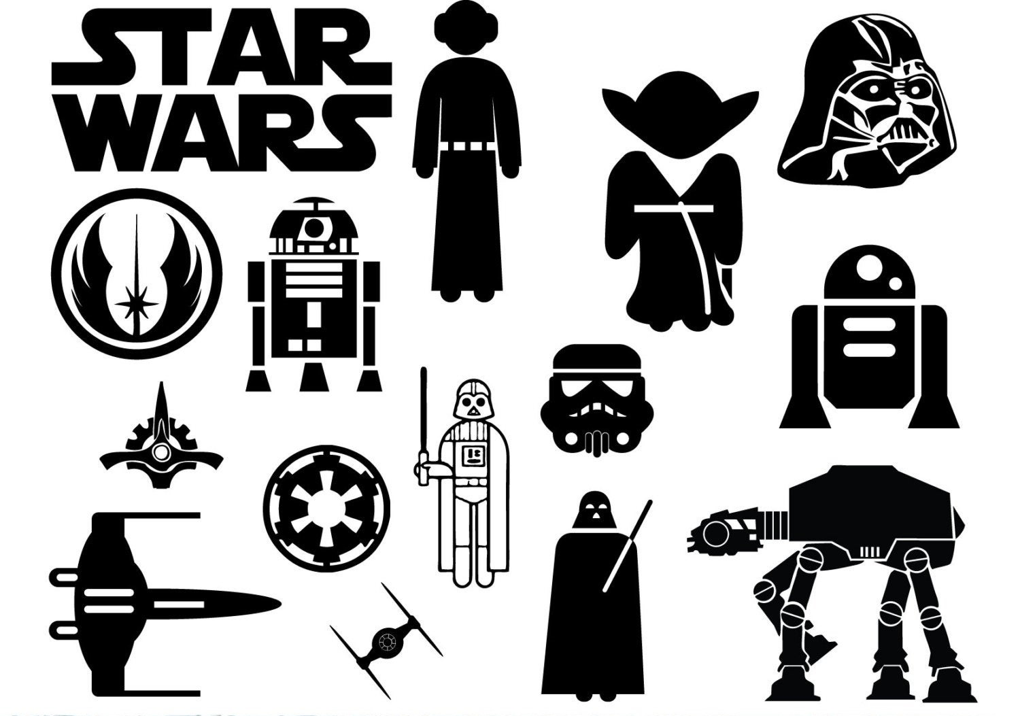
Abstract
Figure 1 Star Wars Universe
The Star Wars universe is a science fiction phenomenon created by the famous director, producer, screenwriter, and entrepreneur, George Lucas. The Star Wars universe is also chock full of characters, planets, species, starships, and vehicles featured in both canon and non-canon (or legends) work. A chatbot or a variant with API manipulation will be built and created from the Star Wars data collected over 40 years through the canon universe.

Slide 3
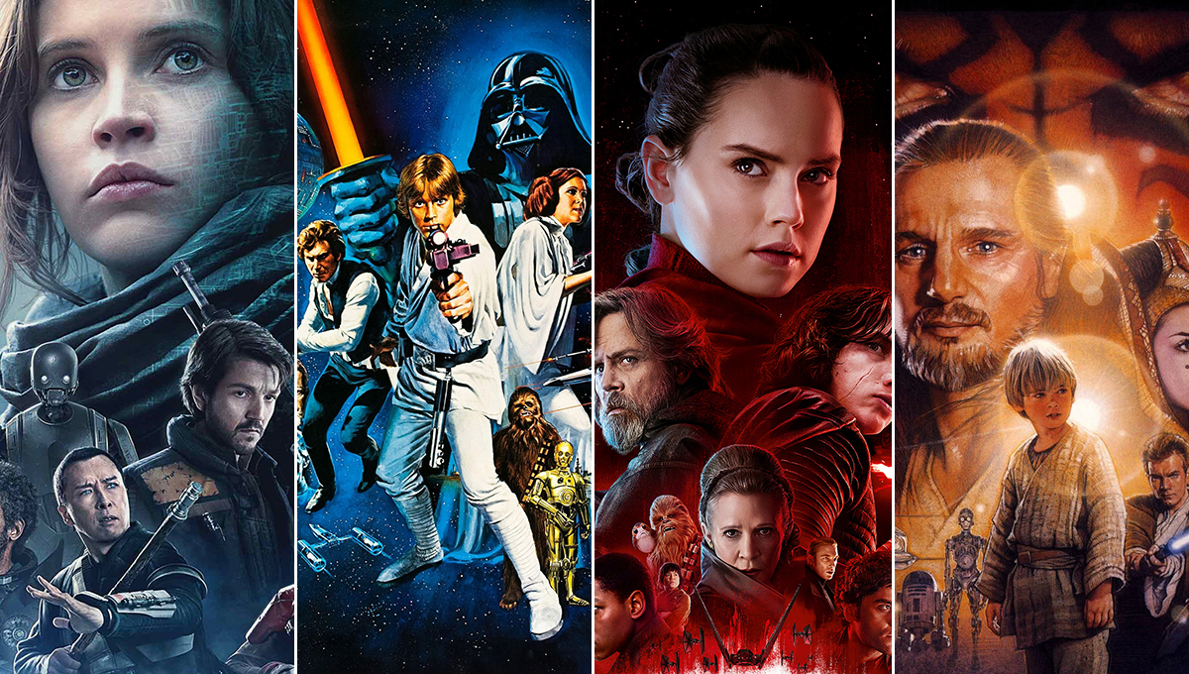
Background
Figure 2 Star Wars Movie Posters
The Star Wars universe has developed into a worldwide marvel featuring: 6 canonical movies (of the most recent sequel trilogy being labeled non-canon), 2 spin-off movies, 1 currently running live-action Disney+ series (of the most current news, 2-4 more upcoming shows, 1 being a spin-off, 1-2 being an original, and 1 possibly being an original from a spin-off movie), 3 canonical animated shows (2 being completed in their programming and 1 currently running), variant specials/earlier animated shows/movies/specials during the rising of the Star Wars franchise, as well as various video games on different platforms, plus numerous toys/merchandise/memorabilia/novelizations/soundtracks/etc. of the galaxy far, far away.

Slide 4
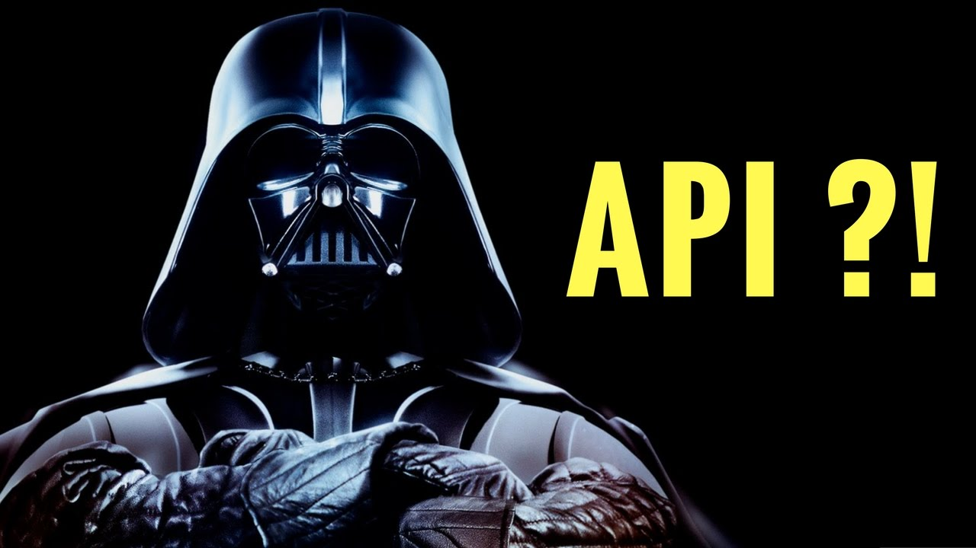
Business understanding
Figure 3 Star Wars API or SWAPI
The Star Wars universe is an ever-growing international icon that features various characters, planets, species, starships, and vehicles told through canon and non-canonical (or legends) work. Hence, a chatbot or a variant with API manipulation will be built and created from the Star Wars data to learn more about the Star Wars universe for fans and potential fans in a simple user-friendly format.

Slide 5
Data understanding – characters & planets
A dataframe with 87 observations and 10 variables.
A dataframe with 61 observations and 9 variables.
(Head)
name height mass hair_color ... birth_year gender homeworld species
0 Luke Skywalker 172.0 77 blond ... 19BBY male Tatooine Human
1 C-3PO 167.0 75 NaN ... 112BBY NaN Tatooine Droid
2 R2-D2 96.0 32 NaN ... 33BBY NaN Naboo Droid
3 Darth Vader 202.0 136 none ... 41.9BBY male Tatooine Human
4 Leia Organa 150.0 49 brown ... 19BBY female Alderaan Human
(Head)
name rotation_period ... surface_water population
0 Alderaan 24.0 ... 40.0 2.000000e+09
1 Yavin IV 24.0 ... 8.0 1.000000e+03
2 Hoth 23.0 ... 100.0 NaN
3 Dagobah 23.0 ... 8.0 NaN
4 Bespin 12.0 ... 0.0 6.000000e+06

Slide 6
data understanding cont. – species & starships
A dataframe with 37 observations and 10 variables.
A dataframe with 37 observations and 13 variables.
(Head)
name classification ... language homeworld
0 Hutt gastropod ... Huttese Nal Hutta
1 Yoda's species mammal ... Galactic basic NaN
2 Trandoshan reptile ... Dosh Trandosha
3 Mon Calamari amphibian ... Mon Calamarian Mon Cala
4 Ewok mammal ... Ewokese Endor
(Head)
name ... starship_class
0 Executor ... Star dreadnought
1 Sentinel-class landing craft ... landing craft
2 Death Star ... Deep Space Mobile Battlestation
3 Millennium Falcon ... Light freighter
4 Y-wing ... assault starfighter

Slide 7
Data understanding cont. - vehicles
A dataframe with 39 observations and 11 variables.
(Head)
name ... vehicle_class
0 Sand Crawler ... wheeled
1 T-16 skyhopper ... repulsorcraft
2 X-34 landspeeder ... repulsorcraft
3 TIE/LN starfighter ... starfighter
4 Snowspeeder ... airspeeder

Slide 8
Data preparation
Due to the fact that these datasets are supplied from Kaggle, there is no Nulls, but there is NA’s, however, there is no data manipulation when remembering the research question due to some characters, planets, species, starships, and vehicles being unapplicable for various statistics/characteristics.

Slide 9
Business question
How can we learn about the Star Wars universe through a chatbot?

Slide 10
assumption
We would be able to create a chatbot or multiple chatbots based off the CSV files of the Star Wars data to learn or better understand the Star Wars universe from canonical work.
No EDA was performed on these datasets due to some characters, planets, species, starships, and vehicles being unapplicable for various statistics/characteristics.

Slide 11
Modeling/methods
To perform this machine learning technique known as chatbots, harnessing the necessary libraries within the programming language, Python, as well as implementing the CSV files to build and create a chatbot is essential to learn about the Star Wars universe. However, the variant with API manipulation is the same and includes wielding user input.

Slide 12
Deployment/results
After building and creating a chatbot or multiple chatbots, a performance check should be implemented but has no relevance in this machine learning technique. However, with the variant in API manipulation and wielding user input, a user is able to extract data about certain characters/planets/species/starships/vehicles.

Slide 13
summary & conclusions
Since the five datasets were structurally formatted in a way where there is no data preparation or wrangling that needs to be done, the more legwork will be building and creating a chatbot or multiple chatbots or an API variant with user input exploitation based off the business question proposed to the business problem of what we can learn or better understand from the Star Wars universe in the form of a simple chatbot or an API variant with user input extraction. Following the CRISP-DM process, after building and creating a chatbot or multiple chatbots, a performance check should be administered but this has no significance to this machine learning technique. Likewise for the API variant with user input wielding capabilities. Lastly, an understanding of how we are able to learn about the Star Wars universe through a chatbot or API variant with user input manipulation will be executed.

Slide 14
Summary & conclusions cont.
Constructing a chatbot was quite difficult and fell out midway due to most of the Star Wars data being a mix of categorical and numerical data. A chatbot is more inclined to textual data only, ergo, the Star Wars data was not appropriate for this machine learning technique.

Slide 15
Summary & Conclusions cont.
Therefore, an API variant with user input manipulation was employed instead. However, even though the API was exercised correctly. extracting data from the API by user input wasn’t able to perform properly, hence the user would just retrieve whatever data they wanted about characters/planets/species/starships/vehicles from clicking on the API url and locating that specific characteristic/statistic about the character/planet/species/starship/vehicle.

Slide 16
Summary & conclusions cont.
Although, a more efficient method could have been utilizing a database (partially in the code) and then withdrawing from said database through SQL coding. In the end, there was a few different modeling/methods (chatbot/multiple chatbots or API variant with user input capabilities or a database through SQL coding) that can transpire upon the Star Wars data (characters/planets/species/starships/vehicles) for deployment/results of exploring the Star Wars universe for fans and potential fans of this science-fiction splendor.

Slide 17
references
Canon. (n.d.). Retrieved from Canon | Wookieepedia | Fandom
George Lucas. (n.d.). Retrieved from George Lucas | Biography, Movies, & Facts | Britannica
Goyal, K. (2020 , July 27). How to Make a Chatbot in Python Step By Step [Python Chatterbox Guide]. How to Make a Chatbot in Python Step By Step [Python Chatterbox Guide] | upGrad blog. upGrad Blog.
How to Build a Chatbot with Python in 4 Easy Steps. (2021, May 12). Retrieved from How to Create a Chatbot in Python [Step-by-Step] | KeyUA
Kharwal, A. (2020, November 1). Chatbot with Machine Learning and Python. Chatbot with Machine Learning and Python (thecleverprogrammer.com). The Clever Programmer.
Krishnan, S. (2018, December 6). Chatbots are cool! A framework using Python. Chatbots are cool! A framework using Python | by Sundar Krishnan | Towards Data Science. Towards Data Science.
Navlani, A. (2020, August 30). Building a Chatbot using Chatterbot in Python. Python Chatterbot: How to Make a Chatbot using Python - DataCamp. DataCamp.
Pickell, D. (2019, February 8). What is a Chatbot? The Full Guide to Chatbots in 2020. What Is a Chatbot? The Full Guide to Chatbots in 2020 (g2.com). G2.
Saba, G. (2018, September 28). Python Chatbot – Build Your Own Chatbot With Python. Python Chatbot - Build Your Own Chatbot With Python (simplifiedpython.net). Simplified Python.
Shahid, U. (2020, June 10). Building an AI-based Chatbot in Python. Building an AI-based Chatbot in Python (datasciencedojo.com). Data Science Dojo.
Star Wars. (n.d.). Retrieved from Star Wars | Wookieepedia | Fandom
Young, J. (2019). Star Wars. Star Wars | Kaggle. Kaggle.

Slide 18
appendices
Appendix A
George Lucas
The article describes George Lucas’ bio including his early work before Star Wars, Star Wars, and the growth of Lucasfilm Ltd.
Appendix B
Canon
The article describes what canon, and the expanded universe is in the Star Wars franchise.
Appendix C
Star Wars
This article describes everything about Star Wars and its origins, including what is considered canon or legends (non-canon), the expanded universe, the several animated or live-action television shows, the numerous books (comics included), and multiple platform video games.

